Slide 1
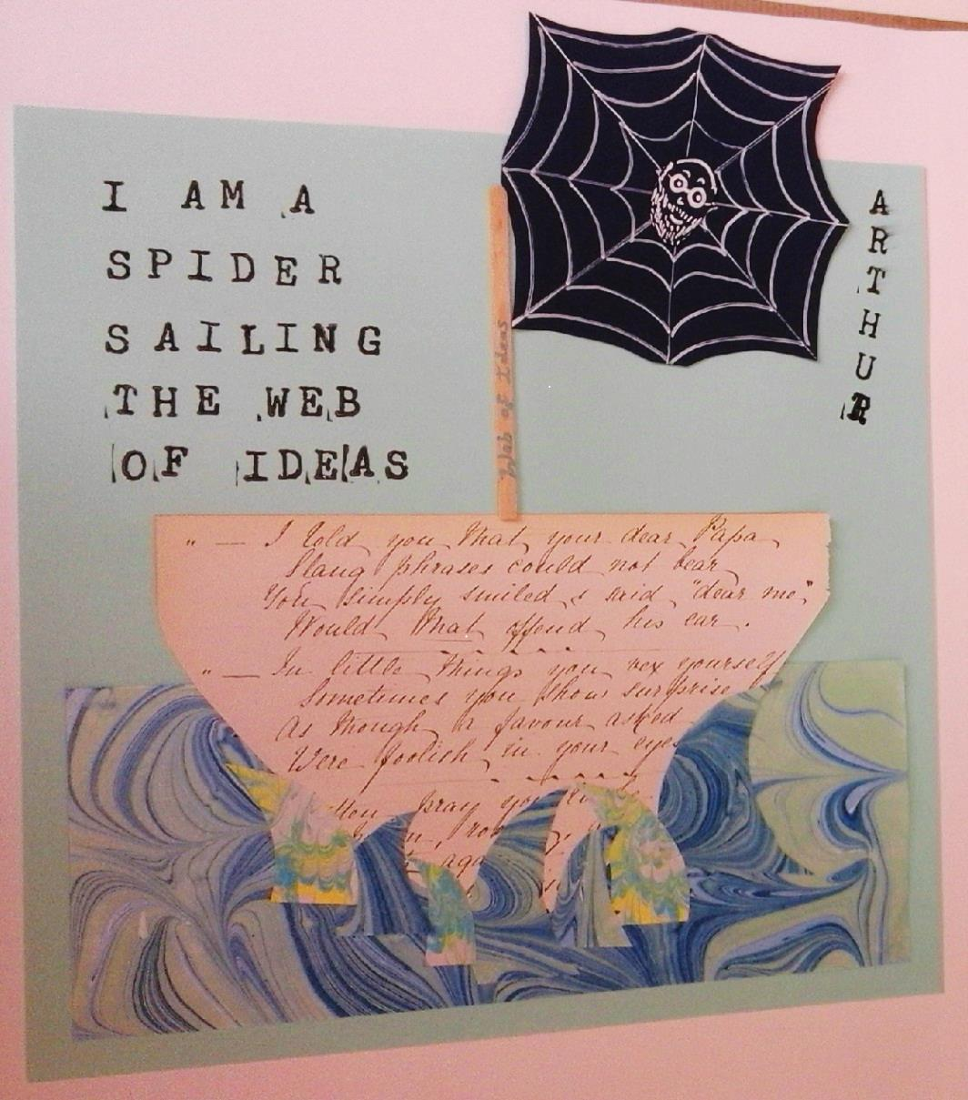
Journeys We Make: research through collaborative storytelling
Dr Cath Heinemeyer
York St John University
c.heinemeyer@yorksj.ac.uk

Slide 2
What is it like being you?
Notes:
Just write down some answers on a piece of paper.

Slide 3
Why have you ended up here today?
Notes:
I don’t just mean, why did you decide to come to this conference – I mean the whole sequence of life events, influences and decisions that lead to you being the sort of person who comes to this sort of education conference. What sort of answers could you give? Does anyone want to volunteer an answer? Draw out whether answers emphasise decisions made, factors beyond your control, influences in your history. Identify where people have told stories.
The point is that there are some experiences you just can’t crystallise into answers. The closest you might come is to tell a story. Or lots of stories. How would you choose which are relevant? And would you feel comfortable sharing them with the person next to you, if I’d asked you to do that? In fact this is the sort of thing we are often putting a research participant through. And sometimes there is a lot hanging on their answer. In fact, and of relevance to the later part of this talk, this particular question above is essentially the question that is put to a refugee who has just arrived, and the answer they give almost instantly assumes the status of a legal document.

Slide 4
When do artistic research processes become necessary?
Where communication needs to be veiled or oblique for safety:
Conquergood 2002:146: “Subordinate peoples do not have the privilege of explicitness, the luxury of transparency, the presumptive norm of clear and direct communication, free and open debate on a level playing field that the privileged classes take for granted.”
Where multiple levels of truth intersect or even contradict each other:
Notes:
What corners can reasoned analysis and conventional social science techniques not reach? I suggest there are two particularly important reasons we need to reach for creative research processes:
Both of these reasons might be considered to be at work in the questions I baldly posed you a minute ago. They also apply to a lot of the most burning questions we need to address in our research and society – including a lot of the questions different people have been addressing in their talks today.

Slide 5
Or to put it another way….
And you are not even sure how to pose the questions (safely, respectfully, rigorously, collaboratively, openly)
When there are no straight answers….
Does social media cause you distress?
Are you less resilient than previous generations?
Do you feel like a victim of neoliberalism?
How much academic pressure can you bear?
Why is there a mental health crisis among young people?
Notes:
To take an example that is key to my research.
None of these questions are particularly answerable – either they require a background experiential knowledge that no young person could have, or they require a disentangling of one aspect of life from every other aspect of life, or they are likely to generate protective or superficial answers, or they seek to extract information young people may not want to give.

Slide 6
Which is where stories come in
Mike Wilson (2014) describes the recent ‘rediscovery of an age-old way of dealing with contradictions, multiple contradictory truths, and distinguishing between truth and lies, redeployed to help us navigate through our rapidly changing and liquid lives.’

Slide 7
From here on in…
Journeys We Make project
Stories as one possible way of finding your questions, and generating answers that can communicate themselves
Questions of RIGOUR

Slide 8
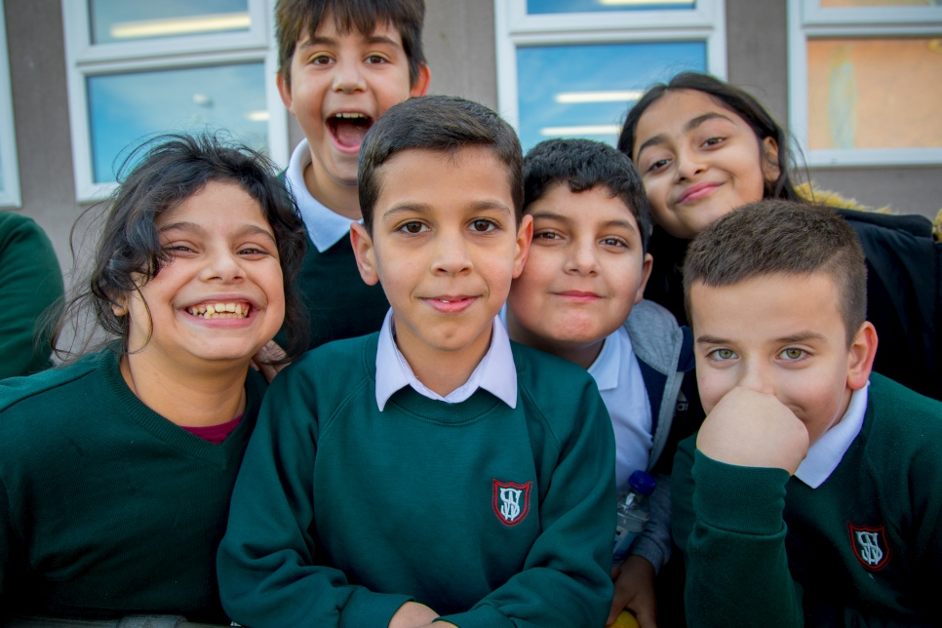
QUESTION: “We often hear teachers frustrated because it’s so difficult to get refugee children to open up – what have they experienced, what are they finding difficult now, and how can we get them to open up about these things?” (inclusion/social mobility charity)
Journeys We Make project - origins
Children at a ‘School of Sanctuary’. Source: UNHCR
Notes:
Teachers are sailing uncharted waters with new arrival pupils – they want to meet their needs, and integrate them into the classroom. Yet they often have difficulties understanding their past experiences and current challenges.

Slide 9
ATTEMPTS AT ANSWER:
Michalis Kakos’ research with new arrivals in British schools: Children are not unwilling to tell their stories but: 1) don’t want these stories to subsume their other stories (“I am 13, I was only a refugee for one year of my life”); 2) don’t want to provoke unpredictable reactions or consequences; 3) wish to protect their listeners from hearing traumatic experiences.
Alison Jeffers (2008): ‘bureaucratic performance’ to authorities conditions every other telling refugees are asked to give of their stories.
Notes:
There is lots going on here – the risk of answering these questions, the questions they would prefer to answer instead, the ‘contamination’ of these answers with answers they have already had to give.

Slide 10
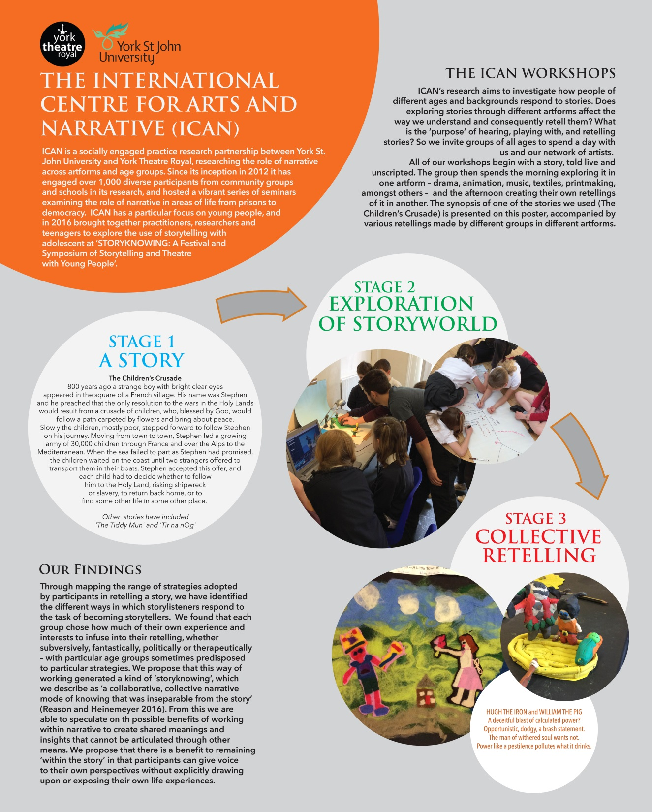
The ICAN approach:
Narrative offers ‘a performance of possible meanings, not a determinate meaning’ (Reason and Heinemeyer 2016:564) – don’t ask what a story is about, but tune into all its layers of meaning.
Notes:
Explain what we did.

Slide 11
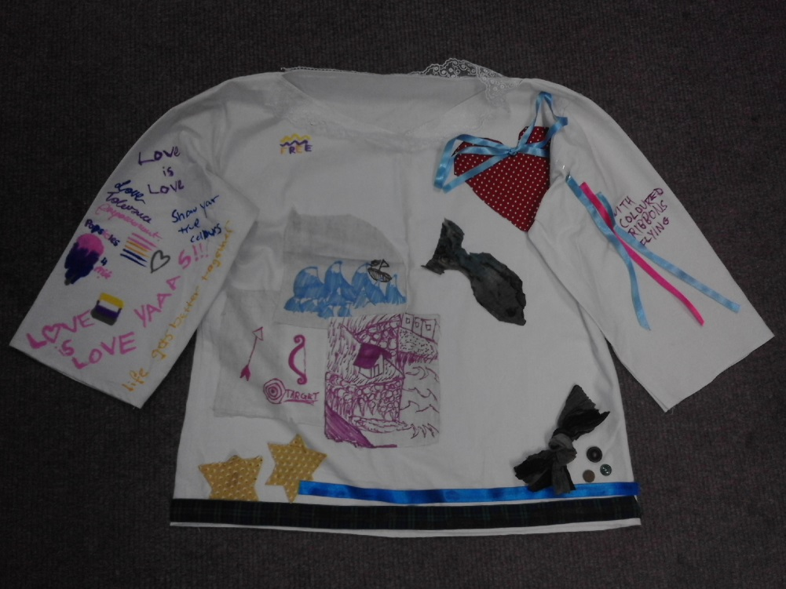
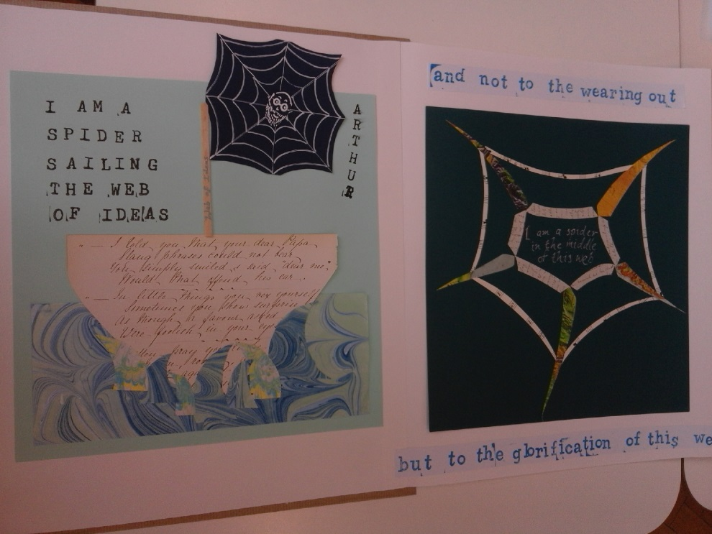
Subsequent projects
Layers Upon Layers (2016)
The Tale Exchange (2018)
And now our practice-as-research project Journeys We Make…
Notes:
Some subsequent projects that have experimented with a similar methodology (but scant detail on these).
In each case, participation was voluntary, collective, exploratory, but all starting with a single story, chosen for the rich and relevant themes which it contained but did not resolve, which everyone became familiar with.

Slide 12
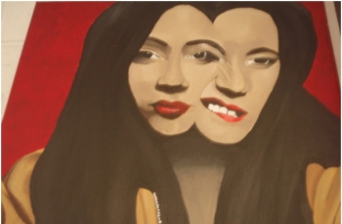
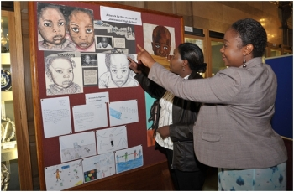
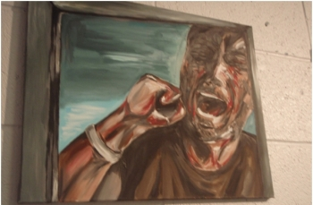
SCHOOL 1
Comprehensive with large percentage of new arrivals among its pupils, as well as pupils from disadvantaged / EAL backgrounds (most participants EAL).
‘School of Sanctuary’.
Notes:
So we decided to try this way of working in two Leeds secondary schools, in which Michalis had been particularly involved. We decided we would include both new arrival and UK-born pupils in the research, and invite them to opt in from all year groups – so it would not all be about the new arrival children, but about the school as a whole and its relationship to migration and identity.

Slide 13
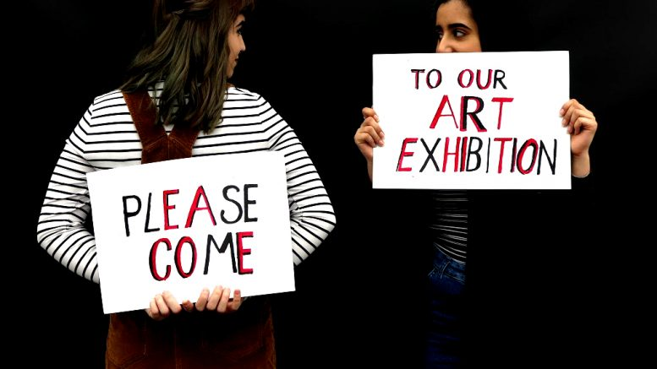
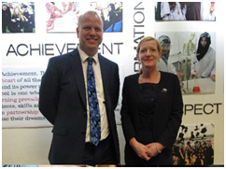
SCHOOL 2
Innovative all-girls’ school placing huge emphasis on arts, oracy and critical thinking
Large majority of pupils of Muslim background; relatively disadvantaged area.
Notes:
We also included Batley, though it does not have many new arrivals, because we did not want to focus entirely on the journey of migration, but how it intersects with other issues of identity in UK schools.

Slide 14
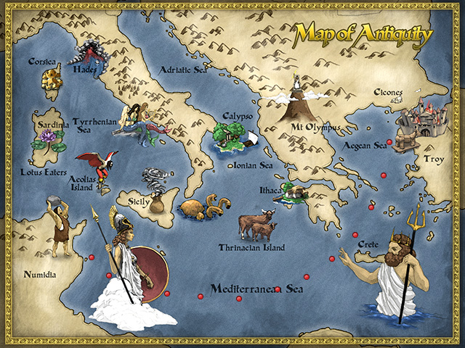
Our canvas: Homer’s Odyssey
Why?
Common property of Eurasian land mass (already intercultural)
Relatively well known – young people already initiated
Orally accreted, and waiting for another layer (Nicolson 2014)
Multiple entry points
Rich ‘generative themes’ (Arizpe et al 2014) of migration, adversity, development, hospitality

Slide 15
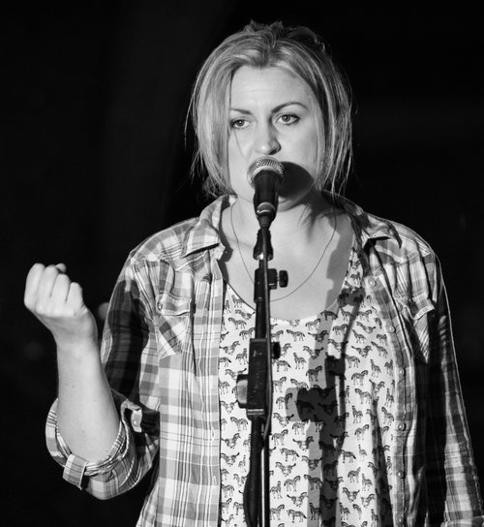
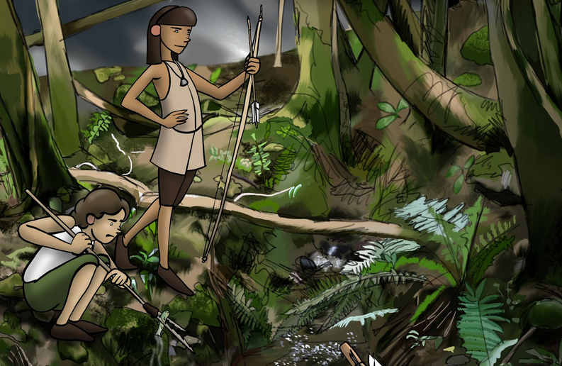
Our chosen artforms: digi-animation and spoken word
Why?
Experience in ICAN workshops of different effects of different artforms on a story.
Rapid and narrative forms – contemporary manifestations of storytelling

Slide 16
Our findings
Different questions
Deep, even avid, engagement in the story, which brought areas of pupils’ experience into the light and dignified them
Use of ‘bodysmarts’ (Luttrell 2003) as a route to understanding
Very little immediate, direct expression of personal journeys/experiences; rather a ‘grey area’ between fact and fiction
Tensions between ownership and desired outcomes, or narrative vs propositional means of expression
More time needed to move beyond technical mastery to self-expression
Vital role of a hospitable ‘ecosystem’

Slide 17
Different questions?
What do these children want to express to their peers and their new schools about the journeys they have made, and how?
How do they want their stories and identities to influence understandings and identities here in their new surroundings?
What does hospitality mean to young people involved in any part of the migration ‘matrix’, as host or guest or both?’
Notes:
Working in this way effectively meant we started with different questions – not ‘how can we get children to open up about their experiences?’ but….
And in fact, this was just our list of questions before the workshops.
In effect, the story is the question, and the young people choose what they want to focus on and interpret from it – so since the workshops happened last week, we could add further questions:

Slide 18
Deep engagement
EAL student at School 1: “(I remembered all of the story because it was) moving; expression; making images in our heads.”
Students’ strong desire to represent particular moments from the story and to fill in the ‘gaps’ in it – to do it justice and bring it to fruition through drama, poetry and animation.

Slide 19
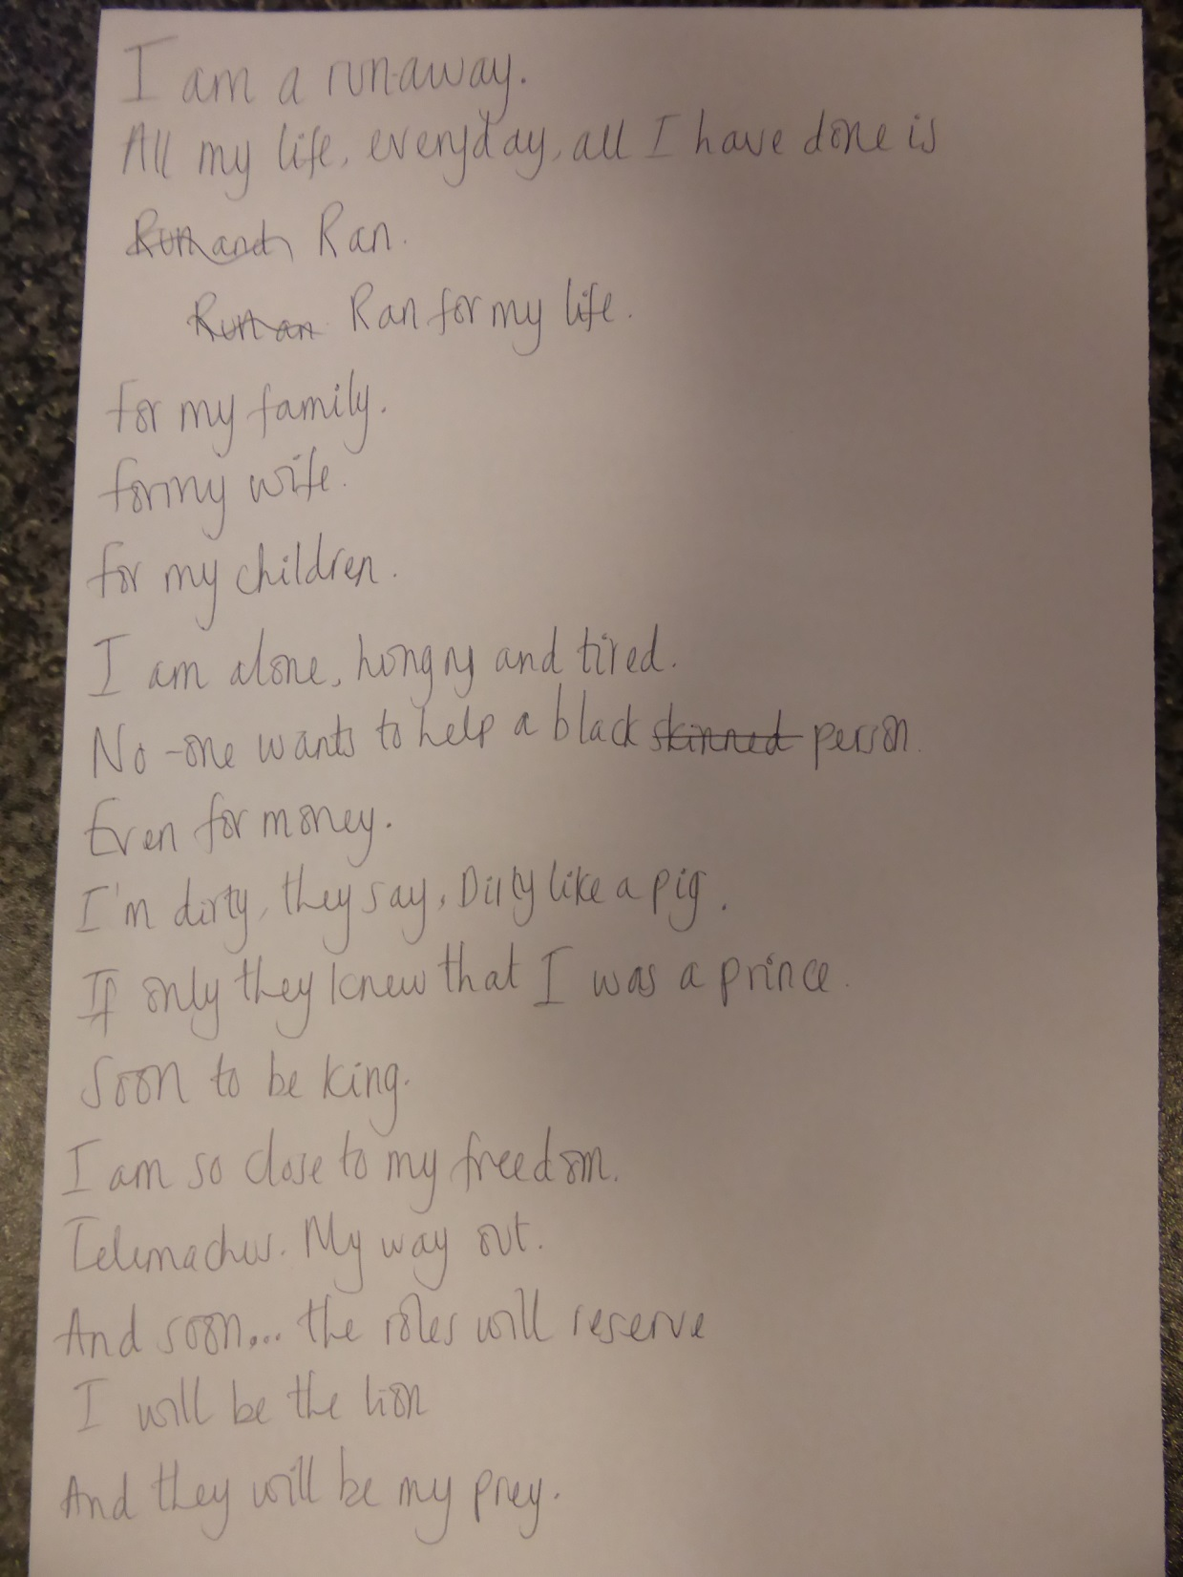
Bodysmarts
Students at school 2 experimenting with physicality of a suppliant and a benefactor, then writing.

Slide 20
A grey area: ongoing conversations
Teacher at School 1, the following day:
“I probed a little and asked the students whether Odysseus' story had made them think about anything in their own lives. Here there was only a Y8 student who said it made her think about "how we moved to a new country". Although the Y9 group I talked to did not explicitly make a link between the Odyssey and their own journeys, the remaining 15 minutes of our lesson were spent in further sharing of their own journey stories with some sharing for the first time and others adding further detail to stories already shared.”

Slide 21
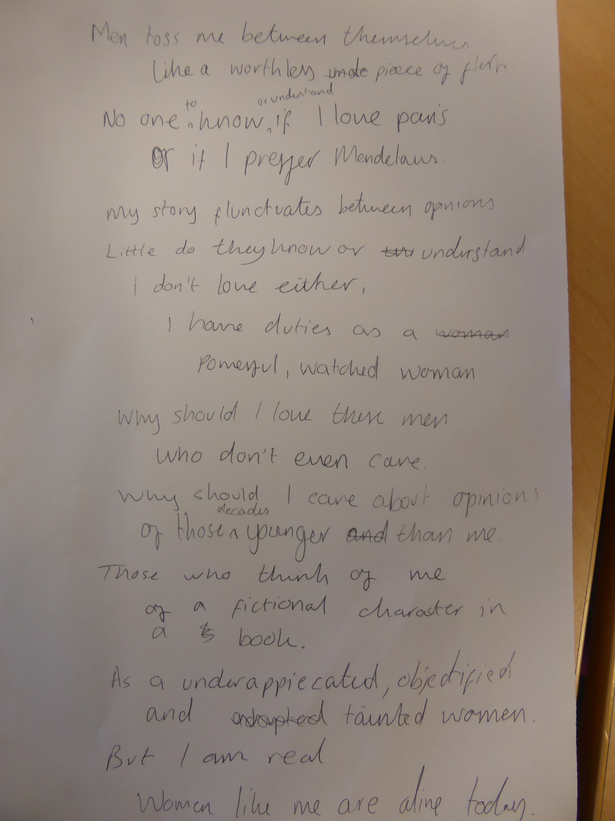
Students, in effect, staked out their own claims on the story by choosing moments in it, e.g.
Odysseus on the misty shore
Did Helen run away or was she kidnapped?

Slide 22
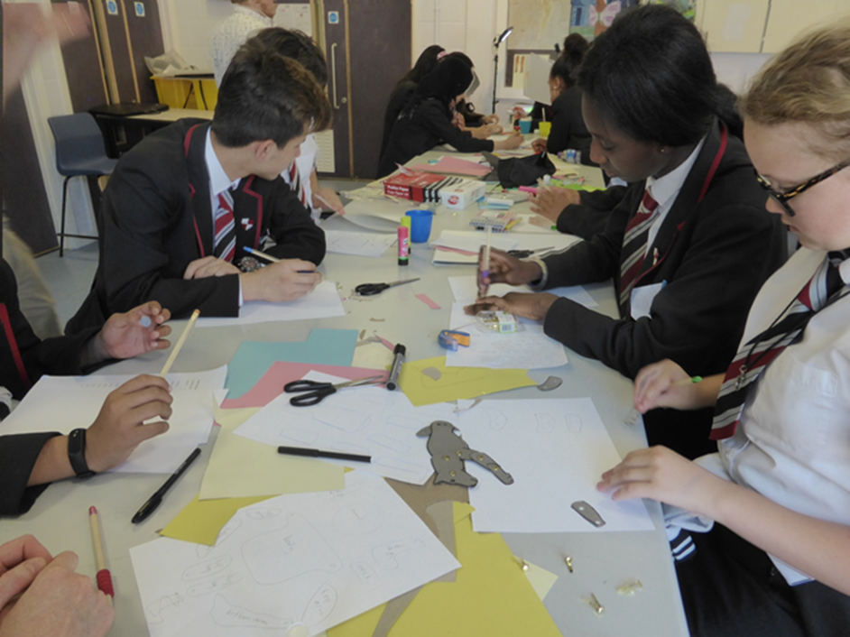
Ownership vs outcomes
"I really loved it fun, lots of chances to mess around" (Teacher’s interpretation: meaning it was relaxed and pleasantly more free-flow than normal lessons)
"we played the same time as learning"
Animation: an unnecessary diversion into technical skills, or a means of ‘spending time’ together in free-flowing conversation and activity linked (or unlinked) to the story?
Or simply a matter of needing more time?
Notes:
I think we have to consider the ‘slow-burning’ effect of the arts – their tendency to open up conversations rather than reach answers, their ongoing existence in our imaginations. Benjamin: ‘while ‘The value of information does not survive the moment in which it was new. It lives only at that moment; it has to surrender to it completely and explain itself to it without losing any time. A story is different. It does not expend itself. It preserves and concentrates its strength and is capable of releasing it even after a long time.’ (p.90)

Slide 23
Role of the ‘ecosystem’
Teacher at School 1: “Our students are lucky to have timetabled music and drama lessons each week in school which offer creative opportunities. Nonetheless, it was a pleasure for me to see our students in this smaller, mixed year group, made up predominantly of students with English as an Additional Language. These students know each other well from other EAL activities and our drop-in classroom which can often tend to take on a family feel. I feel that this additional security may have been a contributing factor in enabling our students to reach out further creatively.”

Slide 24
And where is the RIGOUR?
Robin Nelson (2013) says that in practice-as-research, rigour lies:
in making the tacit more explicit and in establishing resonances between ‘know-what’ and ‘know-that’’ (p.52)
‘in syncretism, not in depth-mining.’ (p.34)
‘ ‘the worked-through-ness of ideas in process’ (p.75)
‘in attempting to find a verbal correlate for the knowledge gained’ (p.90)
Notes:
Just go through what Nelson means on this slide.

Slide 25
How does Journeys We Make measure up?
SYNCRETISM – marrying education and theatre-derived/community arts approaches and ‘snowballing’ – letting one thing lead to another, letting obstructions in one discipline (in this case the problems Michalis encountered with the interview technique) lead you to methods from others.
TACIT → EXPLICIT – articulating what can otherwise only be sensed about the challenges facing young refugees in education – and giving teachers courage to trust and enhance their practice knowledge.
WORKED-THROUGH-NESS – remaining within the realm of story, narrative knowledge
VERBAL CORRELATE – the poem, the film as better expressions of young people’s knowledge and views on this subject than the statement. Hopefully will have a bit of film to show already.

Slide 26
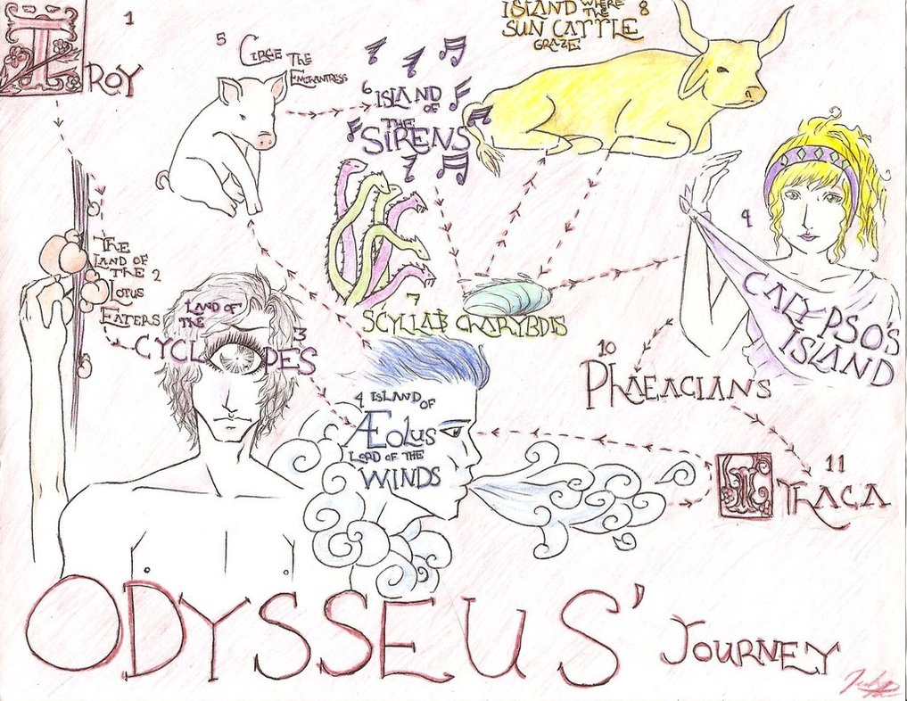
Which method is more rigorous?
Remember the questions I asked you at the start of this.
If I asked you instead, ‘What was it like being Odysseus returning to Ithaca?’
Notes:
would you find it easier to synthesise your thoughts? Draw out what is most important, make sense?
At the end of this pilot project we are left with some challenging questions – whether we can really consider this method to have answered our questions. As Michalis pointed out, very few really told of their personal journeys. But was this our desire?
Mention one young boy’s response – choosing a moment – talking about that feeling of arriving in a country, alone and destitute, and not knowing where you are. Depending on a shepherd.

Slide 27
Our intended outcomes
An exhibition / sharing event
A workshop with initial teacher training students at Leeds Beckett
A booklet to use on their course.
A funding bid for a longer term development of approaches using storytelling and oracy to address complex questions of identity and citizenship in schools.

Slide 28
References
Arizpe E., Bagelman C., Devlin A.M., Farrell M. and McAdam J.E. (2014) ‘Visualizing intercultural literacy: engaging critically with diversity and migration in the classroom through an image-based approach’, Language and Intercultural Communication 14:3, 304-321.
Benjamin, Walter (1973(1955)) ‘The Storyteller: Reflections on the Works of Nikolai Leskov’, pp.83-109 in Hannah Arendt (ed). Illuminations. London: Fontana.
Conquergood, Dwight (2002) ‘Performance Studies: Interventions and Radical Research’. The Drama Review 46:2, 145-156.
Luttrell, Wendy (2003) Pregnant Bodies, Fertile Minds: Gender, Race, and the Schooling of Pregnant Teens. New York: Routledge
Nelson, Robin (2013) Practice as Research in the Arts: Principles, Protocols, Pedagogies, Resistances. Basingstoke: Palgrave MacMillan.
Nicolson A (2014) The Mighty Dead: why Homer matters. London: William Collins.
Reason, Matthew & Heinemeyer, Catherine (2016) ‘Storytelling, story-retelling, storyknowing: towards a participatory practice of storytelling’, Research in Drama Education: The Journal of Applied Theatre and Performance 21:4, 558-573.
Wilson, Michael (2014) ‘The Dualities and the Multiplicities of the Storytelling Voice: what we might take from Millais and Benjamin.’ Presented at Storytelling and the Voice Symposium, University of Cardiff, 05/04/2014.

